Slide 1
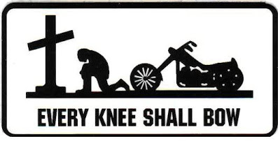
Philippians 2.9-11
Image from ChristianBrotherhoodMM.blogspot.com

Slide 2
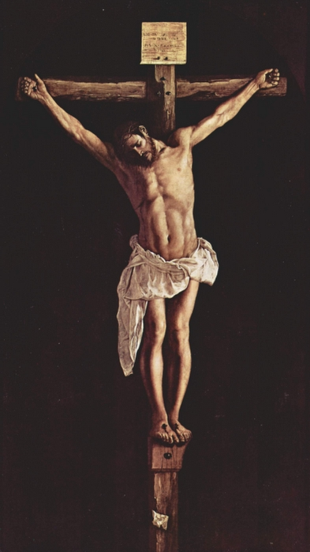
Philippians 2.5-8 NIV: In your relationships with one another, have the same mindset as Christ Jesus: Who, being in very nature God, did not consider equality with God something to be used to his own advantage; rather, he made himself nothing by taking the very nature of a servant, being made in human likeness. And being found in appearance as a man, he humbled himself by becoming obedient to death-- even death on a cross!
Image by Francisco de Zurbaran
courtesy of Vanderbilt.edu

Slide 3
Philippians 2.9-11 NIV: Therefore God exalted him to the highest place and gave him the name that is above every name, that at the name of Jesus every knee should bow, in heaven and on earth and under the earth, and every tongue acknowledge that Jesus Christ is Lord, to the glory of God the Father.
Summit above Philippi
Image ©2012 Todd Bolen / BiblePlaces.com

Slide 4
Philippians 2.9-11 NIV: Therefore God exalted him to the highest place and gave him the name that is above every name, that at the name of Jesus every knee should bow, in heaven and on earth and under the earth, and every tongue acknowledge that Jesus Christ is Lord, to the glory of God the Father.
ὑπερυψόω =
I super-exalt

Slide 5
Philippians 2.9-11 NIV: Therefore God exalted him to the highest place and gave him the name that is above every name, that at the name of Jesus every knee should bow, in heaven and on earth and under the earth, and every tongue acknowledge that Jesus Christ is Lord, to the glory of God the Father.
χαρίζομαι =
I freely give

Slide 6
Philippians 2.9-11 NIV: Therefore God exalted him to the highest place and gave him the name that is above every name, that at the name of Jesus every knee should bow, in heaven and on earth and under the earth, and every tongue acknowledge that Jesus Christ is Lord, to the glory of God the Father.

Slide 7
Philippians 2.9-11 NIV: Therefore God exalted him to the highest place and gave him the name that is above every name, that at the name of Jesus every knee should bow, in heaven and on earth and under the earth, and every tongue acknowledge that Jesus Christ is Lord, to the glory of God the Father.

Slide 8
Philippians 2.9-11 NIV: Therefore God exalted him to the highest place and gave him the name that is above every name, that at the name of Jesus every knee should bow, in heaven and on earth and under the earth, and every tongue acknowledge that Jesus Christ is Lord, to the glory of God the Father.

Slide 9
Philippians 2.9-11 NIV: Therefore God exalted him to the highest place and gave him the name that is above every name, that at the name of Jesus every knee should bow, in heaven and on earth and under the earth, and every tongue acknowledge that Jesus Christ is Lord, to the glory of God the Father.

Slide 10
Isaiah 45.18-25 NASB: For thus says the LORD [Yahweh], who created the heavens (He is the God who formed the earth and made it, He established it and did not create it a waste place, but formed it to be inhabited), “I am the LORD [Yahweh], and there is none else. I have not spoken in secret, In some dark land; I did not say to the offspring of Jacob, ‘Seek Me in a waste place’; I, the LORD [Yahweh], speak righteousness, declaring things that are upright. Gather yourselves and come; draw near together, you fugitives of the nations; they have no knowledge, who carry about their wooden idol and pray to a god who cannot save. Declare and set forth your case; Indeed, let them consult together.

Slide 11
Who has announced this from of old? Who has long since declared it? Is it not I, the LORD [Yahweh]? And there is no other God besides Me, a righteous God and a Savior; there is none except Me. Turn to Me and be saved, all the ends of the earth; For I am God, and there is no other. I have sworn by Myself, the word has gone forth from My mouth in righteousness and will not turn back, that to Me [to Yahweh] every knee will bow, every tongue will swear allegiance. They will say of Me, ‘Only in the LORD [Yahweh] are righteousness and strength.’ Men will come to Him, and all who were angry at Him will be put to shame. In the LORD [Yahweh] all the offspring of Israel will be justified and will glory.”

Slide 12
Philippians 2: at the name of Jesus every knee should bow, in heaven and on earth and under the earth, and every tongue acknowledge that Jesus Christ is Lord, to the glory of God the Father.
Isaiah 45: that to Me [Yahweh] every knee will bow, every tongue will swear allegiance.

Slide 13
Philippians 2.10-11: …at the name of Jesus every knee should bow, in heaven and on earth and under the earth, and every tongue acknowledge that Jesus Christ is Lord, to the glory of God the Father.
definite in Greek: “the LORD”

Slide 14
Philippians 2.5-11 NIV: In your relationships with one another, have the same mindset as Christ Jesus: Who, being in very nature God, did not consider equality with God something to be used to his own advantage; rather, he made himself nothing by taking the very nature of a servant, being made in human likeness. And being found in appearance as a man, he humbled himself by becoming obedient to death-- even death on a cross! Therefore God exalted him to the highest place and gave him the name that is above every name, that at the name of Jesus every knee should bow, in heaven and on earth and under the earth, and every tongue acknowledge that Jesus Christ is [the] Lord, to the glory of God the Father.

Slide 15
Philippians 2.5-11 NIV: In your relationships with one another, have the same mindset as Christ Jesus: Who, being in very nature God, did not consider equality with God something to be used to his own advantage; rather, he made himself nothing by taking the very nature of a servant, being made in human likeness. And being found in appearance as a man, he humbled himself by becoming obedient to death-- even death on a cross! Therefore God exalted him to the highest place and gave him the name that is above every name, that at the name of Jesus every knee should bow, in heaven and on earth and under the earth, and every tongue acknowledge that Jesus Christ is [the] Lord, to the glory of God the Father.

Slide 16
Relationship
Confess your faith in Jesus as the Son of God and as the Christ [Messiah-savior].

Slide 17
Relationship
Confess your faith in Jesus as the Son of God and as the Christ [Messiah-savior].
Submit to obey Jesus as master/ruler of life.

Slide 18
Relationship
Confess your faith in Jesus as the Son of God and as the Christ [Messiah-savior].
Submit to obey Jesus as master/ruler of life.
Follow Jesus’ example of how to live.

Slide 19
Humility
Jesus’ Teaching: Matthew 23.11-12 NIV: “The greatest among you will be your servant. For those who exalt themselves will be humbled, and those who humble themselves will be exalted.”
Jesus’ Example: He humbled himself so God the Father exalted him.

Slide 20
Purpose
Obey the command to contend side by side for the gospel, to pursue the gospel mission.
Follow the Example of Christ who sacrificed and suffered so we could have eternal life.

Slide 21
Philippians 2.7 NIV: he made himself nothing
by taking the very nature of a servant,
being made in human likeness.
kενόω = I empty

